Slide 1
Disabilities under RPD Bill 2016 and its understanding
Dr. Alok Kumar “Bhuwan”
Manovikas, Delhi

Slide 2
Agenda
List of 21 disabilities under RPD Bill- 5m
What is common symptoms in 21 disabilities – 40m
Why do we understand Disability?- 20m
Group Activity 60m

Slide 3
List of 21 disabilities under RPD Bill
Locomotor disability
Muscular Dystrophy
Leprosy cured
Dwarfism
Cerebral Palsy
Acid attack Victim
Low vision
Blindness
Deaf
Hard of Hearing
Speech and Language disability
Intellectual Disability
Specific Learning Disability
Autism Spectrum Disorder
Mental illness
Chronic Neurological Conditions
Multiple sclerosis
Parkinson’s disease
Haemophilia
Thalassemia
Sickle Cell disease

Slide 4
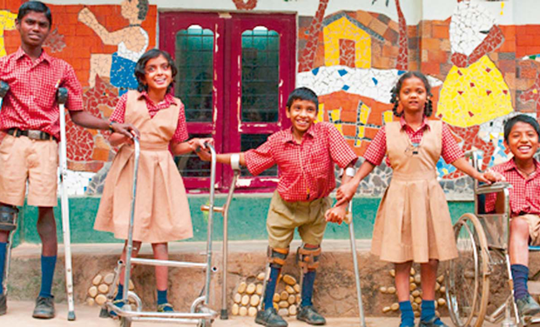
Locomotor disability

Slide 5
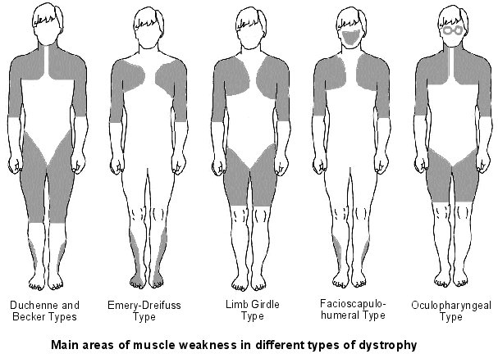
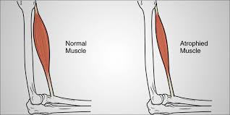
Muscular Dystrophy

Slide 6
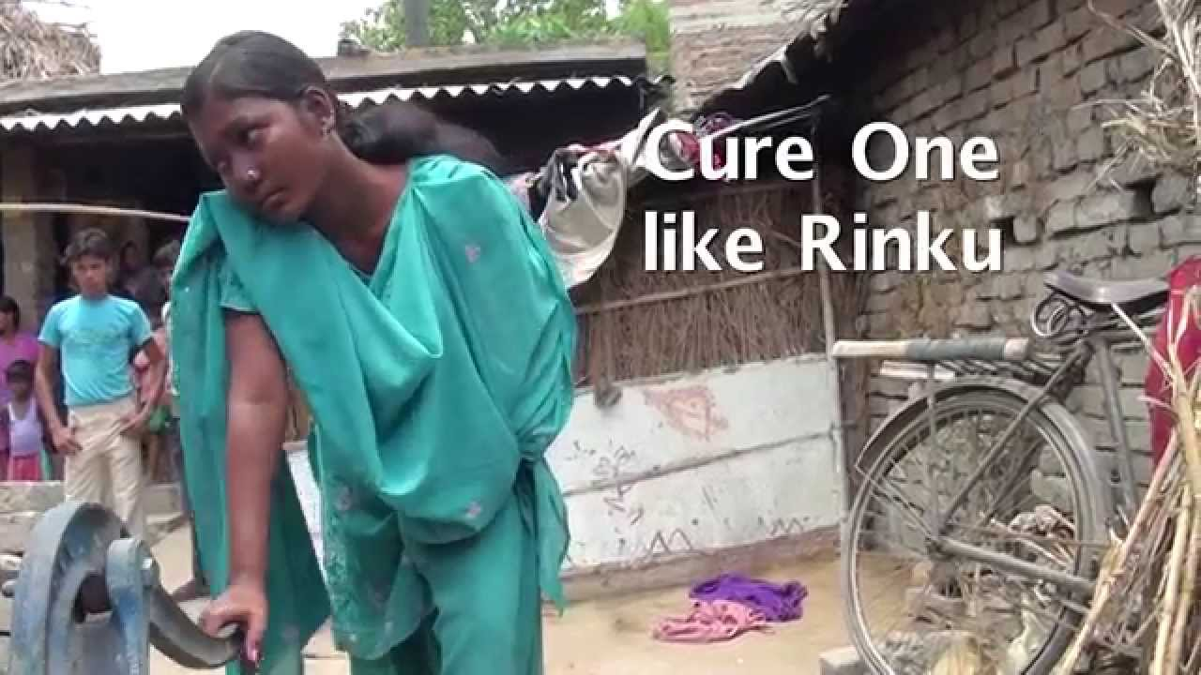
Leprosy cured

Slide 7
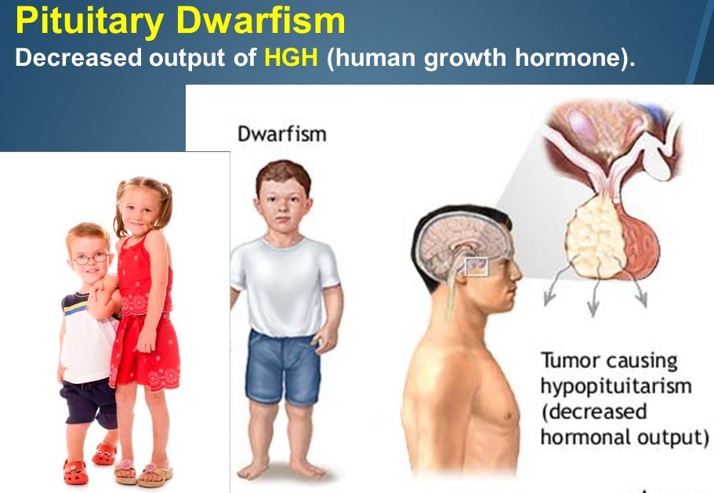
Dwarfism

Slide 8
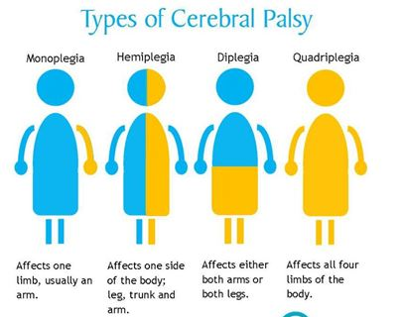
Cerebral Palsy

Slide 9
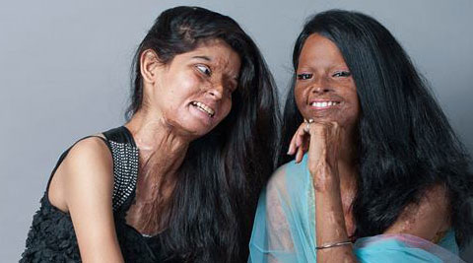
Acid attack Victim

Slide 10
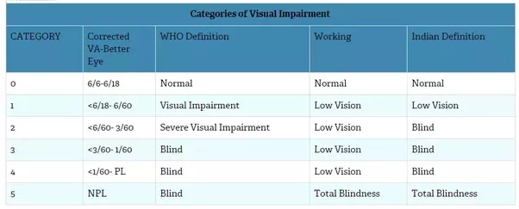
Low vision
Blindness

Slide 11
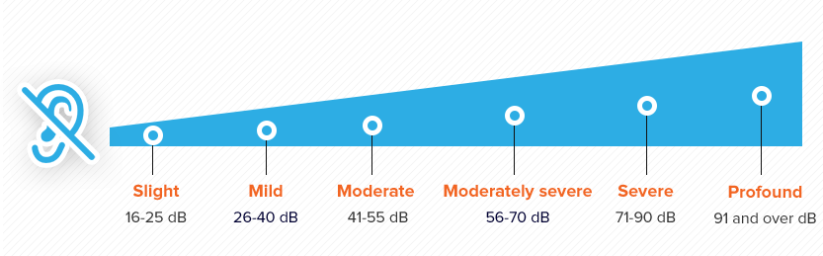
Deaf
Hard of Hearing

Slide 12

Speech and Language disability

Slide 13
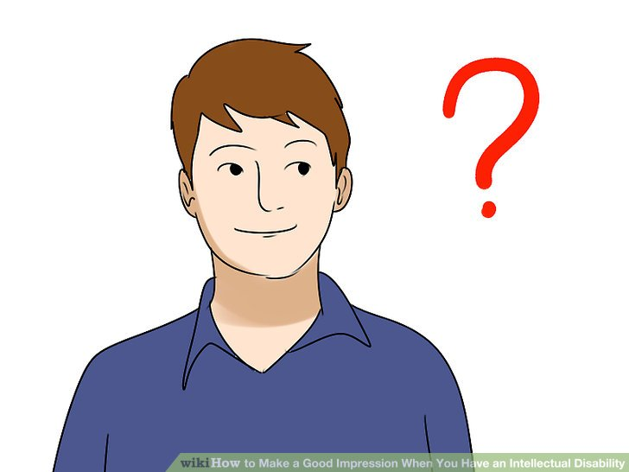
Intellectual Disability

Slide 14
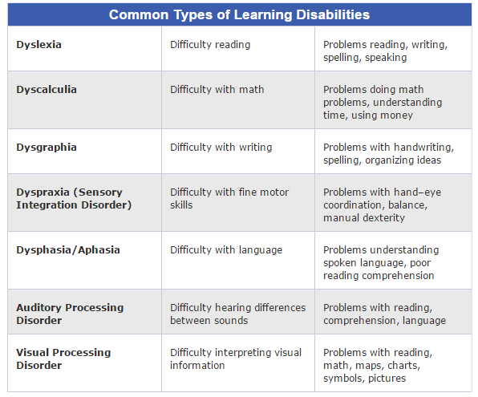
Specific Learning Disability

Slide 15
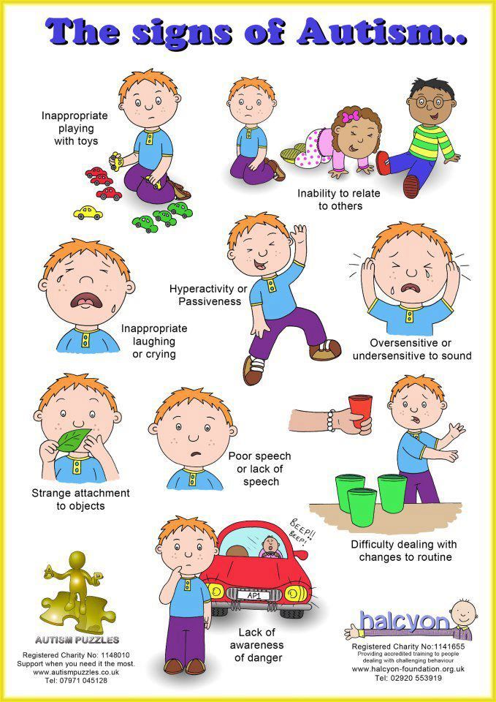
Autism Spectrum Disorder

Slide 16

Mental illness

Slide 17
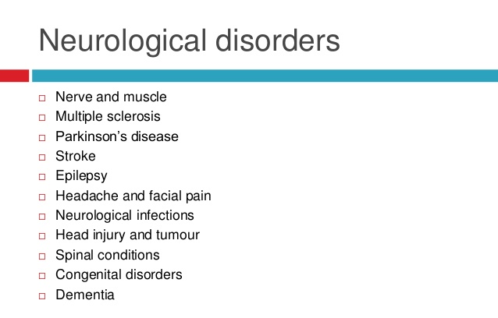
Chronic Neurological Conditions

Slide 18
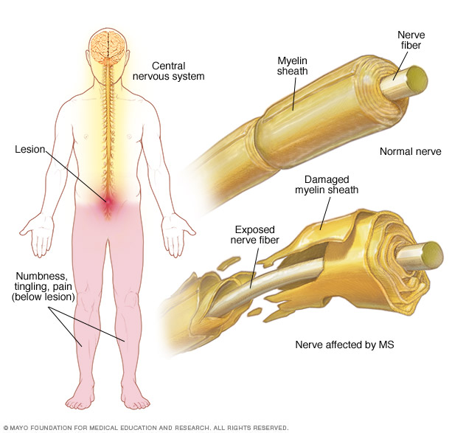
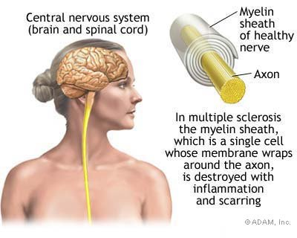
Multiple sclerosis

Slide 19
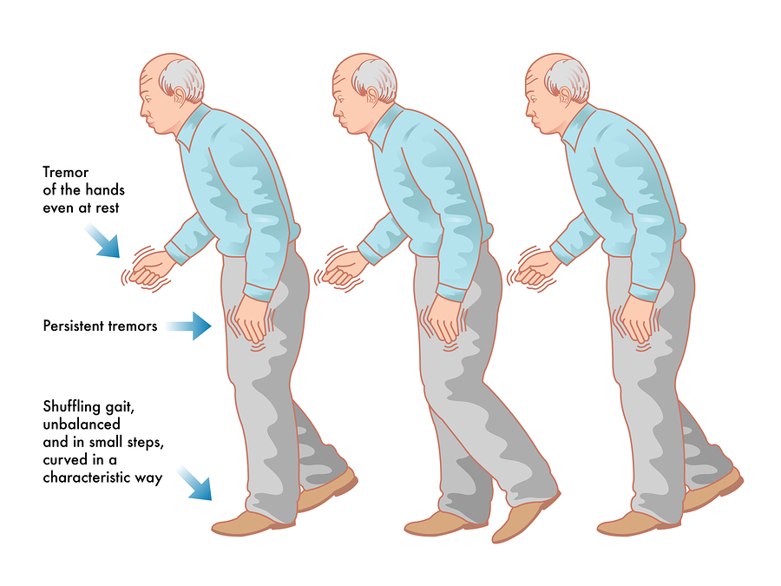
Parkinson’s disease

Slide 20
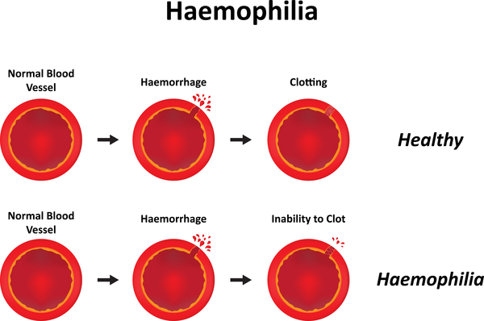

Slide 21
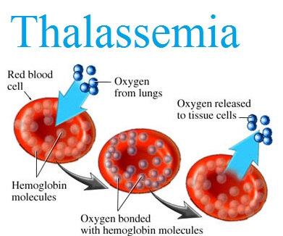
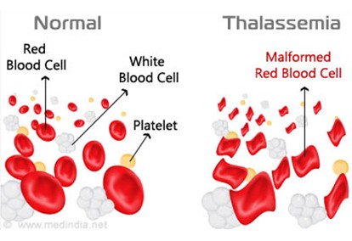

Slide 22
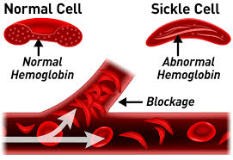
Sickle Cell disease

Slide 23
Why do we understand Disability?
For SERVICE Provisions
At the individual level…
At the institutional level…
At the social level…

Slide 24
Why do we understand Disability?
At the individual level
Assessment, Treatment planning, evaluation and other interventions, for communication among physicians, nurses, physiotherapists, occupational therapists and other health works, social service works and community agencies and for self-evaluation by consumers
How would I rate my capacity in mobility or communication?
At the institutional level…
Educational and training purposes, resource planning and development, quality improvement, management and outcome evaluation, managed care models of health care delivery
At the social level…
Eligibility criteria for state entitlements such as social security benefits, disability pensions, workers’ compensation and insurance : Are the criteria for eligibility for disability benefits evidence based, appropriate to social goals and justifiable?
Social policy development, including legislative reviews, model legislation, regulations and guidelines, and definitions for anti-discrimination legislation: Will guaranteeing rights improve functioning at the societal level? Can we measure this improvement and adjust our policy and law accordingly?
For needs assessments: What are the needs of persons with various levels of disability - impairments, activity limitations and participation restrictions?
For environmental assessment for universal design, implementation of mandated accessibility, identification of environmental facilitators and barriers, and changes to social policy: How can we make the social and built environment more accessible for all person, those with and those without disabilities? Can we assess and measure improvement?

Slide 25
Group Activity 60m
Blind Instructions
Imagination
Sound Walk
Notes:
Body Functions are physiological functions of body systems (including
psychological functions).
Body Structures are anatomical parts of the body such as organs, limbs and
their components.
Impairments are problems in body function or structure such as a significant
deviation or loss.
Activity is the execution of a task or action by an individual.
Participation is involvement in a life situation.
Activity Limitations are difficulties an individual may have in executing
activities.
Participation Restrictions are problems an individual may experience in
involvement in life situations.
Environmental Factors make up the physical, socal and attitudinal
environment in which people live and conduct their lives..

Slide 26
Blind Instructions
Body Functions and Body Structure:
how we know determine what is correct or incorrect
1) Each person draws a simple picture using basic shapes.
2) Choose partners and sit back to back. Decide who will be partner (A) and partner (B).
3) Partner (A) will give partner (B) instructions on how to recreate (A)’s drawing.
4) Compare the drawings.
5) Switch partners. Now partner (B) gives instructions to have partner (A) recreate their drawing.
Notes:
Time required: 30 mins
Equipment required: paper and pen
Age range: 14+
Of all the facilitation games we use, this one allows groups to talk about communication. In particular conversations can arise about listening, giving clear instructions, and how we know determine what is correct or incorrect. It is a fun challenge, and can be played more than once to get a group tuned into listening and connecting. It gives partners an opportunity to talk about their particular communication styles and strategize ways to optimize their communication.
1) Each person draws a simple picture using basic shapes.
2) Choose partners and sit back to back. Decide who will be partner (A) and partner (B).
3) Partner (A) will give partner (B) instructions on how to recreate (A)’s drawing.
4) Compare the drawings.
5) Switch partners. Now partner (B) gives instructions to have partner (A) recreate their drawing.
6) Compare the drawings.
7) Discuss the process and results between partners.
8) Facilitate a group discussion about what happened for each group, and what can be learned about communication and giving instructions.

Slide 27
Imagination
Activity & Participation
activity in silence with no talking
entering into their own imagination
a sense of containment but move freely
allow others to have their own private experience.
Notes:
Opening Activity
Contributor: Eric Mulholland
Time required: 10-15 mins
Equipment required: none
Age range: 14+
Purpose: To open up the imagination, foster a sense of play, engaging the imagination with physical expression and begin learning how to work privately in public.
The class begins milling around a large empty space. The instructor tells the students to walk in a neutral way, just noticing qualities of the space. After a minute or so, tell the students to notice the other students in the room. At this point, tell the class that they are going to take a trip into their imagination. As they mill about, with the instructors participation, have them imagine a series of ways to move through the space.
For example: “You are walking through thick mud….barefoot in the desert…ankle, knee, waist deep in water…swimming under water…floating in outer-space…walking on the moon”. When coming to an end, have the students gradually re-enter the space by milling about in a neutral way once again until you bring the class to a complete stop.
Facilitation Tips: Make sure the students do this activity in silence with no talking, each one entering into their own imagination. The playing space can be outlined to create a sense of containment but be sure it is large enough for the students to move freely. Give continuous reminders that this is an activity for students to do in a group but to allow others to have their own private experience.

Slide 28
Sound Walk
Environmental Factors:
This is a meditative observing activity and helps to tune into their sense of place, and helps build focus and awareness.
1) Each person finds a spot to sit alone and spends five minutes just observing to the world.
2) Make a circle and share the observation one at a time. Let each person teach their observation to the group. The group can try to guess the observation
3) Someone to repeat their observation. Encourage them to copy each other. A singe observation can become a flock of day!
Notes:
Workshop Games: Sound Walk
Time required: 30 mins
Equipment required: a place where youth can safely sit outdoors
Ideal group size: 5-15
Age range: 12+
This is a meditative listening activity that leads to a fun and silly sound circle. It helps the group tune into their sense of place, and helps build focus and awareness.
1) Each person finds a spot to sit alone and spends five minutes just listening to the world. Ask them to listen for “their” sound. It should be something they can mimic. It doesn’t have to be exact. It should be something they can remember.
2) Make a circle and share the sounds one at a time. Let each person teach their sound to the group. The group can try to guess the sound
3) Begin to walk together on a beat.
4) Someone to repeat their sound. Go around the circle, each person adding their sound to the circle. Encourage people to alter their sound in pitch, volume and duration. Encourage them to copy each other. A singe bird sound can become a flock of birds!
5) Remind the group to keep the beat, keep listening to each other, and to leave enough silence for the music of the world to breathe.

Slide 29
Conclusion
Body Functions: Negative scale used to indicate the extent or magnitude of an impairment
Body Structure: Negative scale used to indicate the extent or magnitude of an impairment

Slide 30
Conclusion
Activity & Participation:
PERFORMANCE: Problem in the person's current
Environment
CAPACITY: Limitation without assistance
Environmental Factors: positive scale to denote extent of barriers and facilitators respectively

Slide 31

The person-centered planning approach, making choices and exploring career interests are to be supported and encouraged

Slide 32
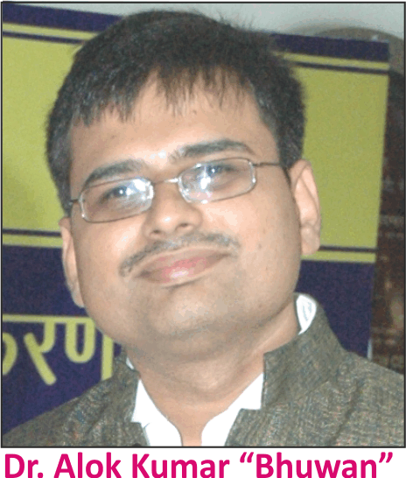
Thank You
Dr. Alok’s Professional Qualifications:
• Doctor of Art in Special Education, USA
• Master of Science in Rehabilitation Science, USA
Master of Art in Distance Education, IGNOU
• M. Ed. in Special Education (Hearing Impairment), Osmania University
• B. Ed. in Special Education (Hearing Impairment), MPBOU
• B.Sc. (Honors) Phy, BNMU
• Diploma in Vocational Training & Employment (Mental Retardation), NIMH
• Professional Practice Certificate in Autism Spectrum Disorders (AAS, USA)
• SPELD-SA Teaching a Child to Read and Write (e3-Learning USA)
• Making Your Case – on how to communicate with Public Officials, Council on DD, USA
• Professional Certificate in Sexuality Education for Persons with Developmental Disabilities
• Diploma in Mass Communication & Journalism, IUMCJ
• Certificate in Office, Administration and Management

Slide 33


1

